Slide 1
ETSIAMN
SCHOOL OF
AGRICULTURAL
ENGINEERING
AND ENVIRONMENT

Slide 2
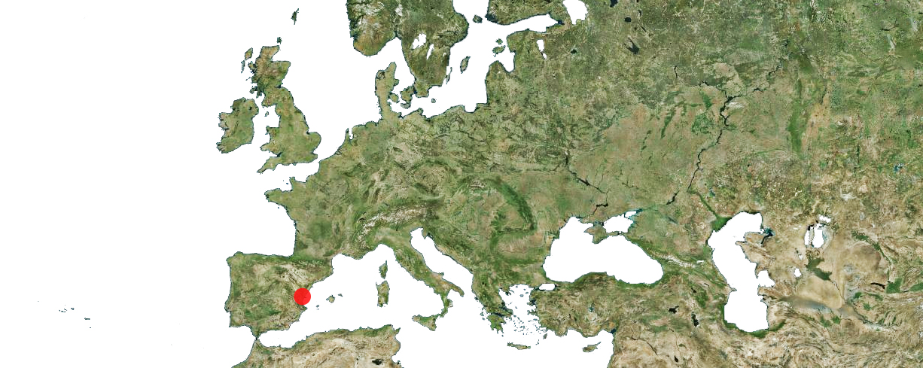
VALENCIA

Slide 3
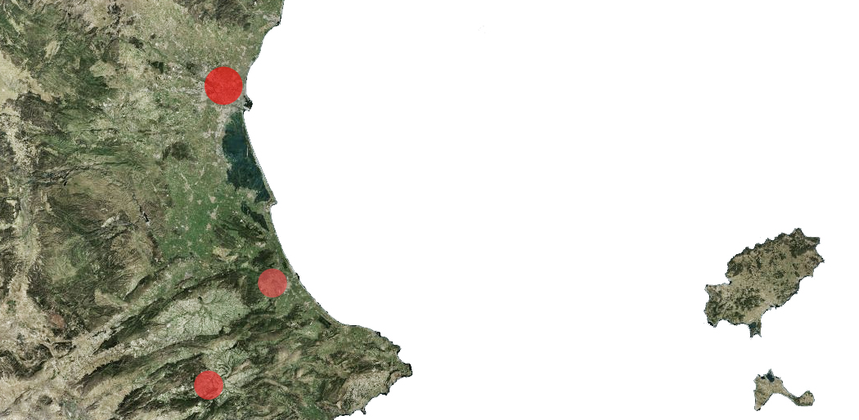
Campus Vera (Valencia)
Campus Gandia
Campus Alcoy

Slide 4
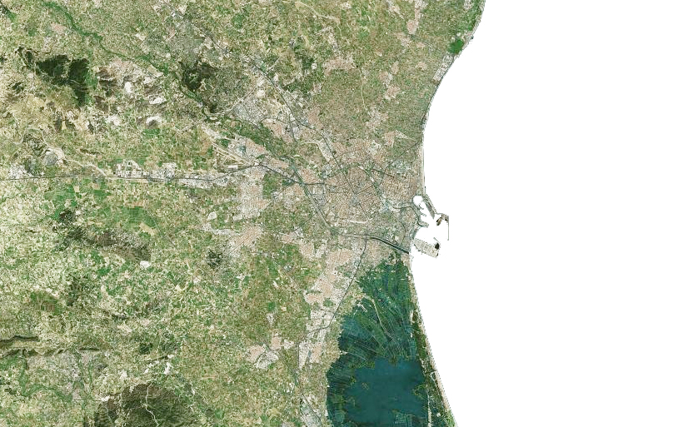
VALENCIA

Slide 5
LANDSCAPES

Slide 6
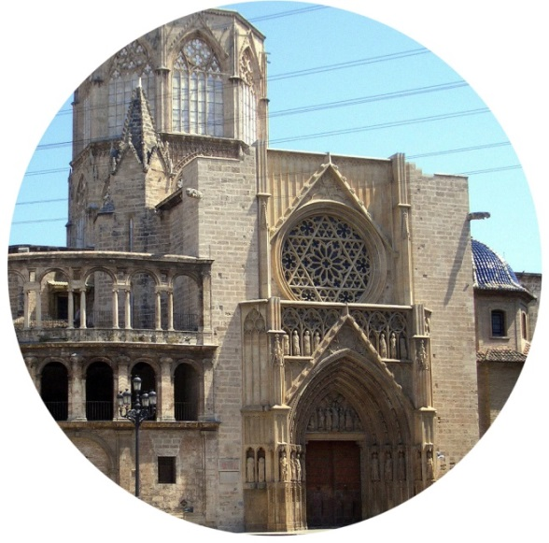
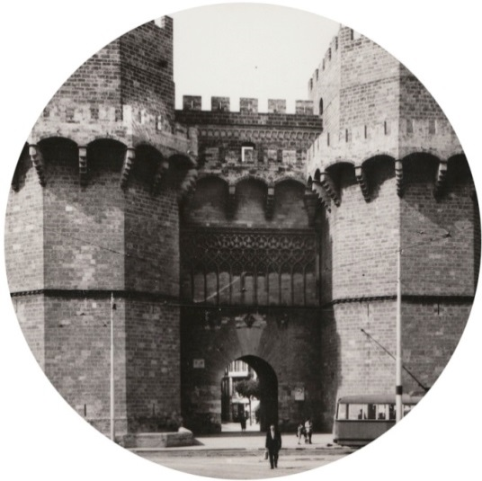
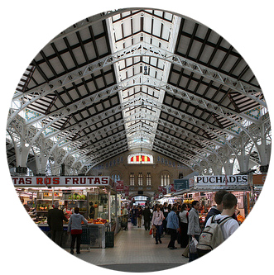
HISTORY

Slide 7
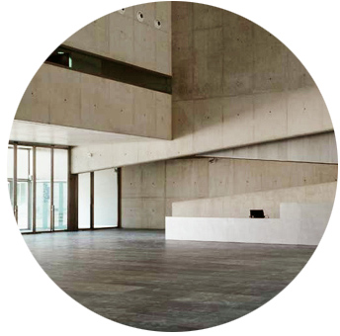
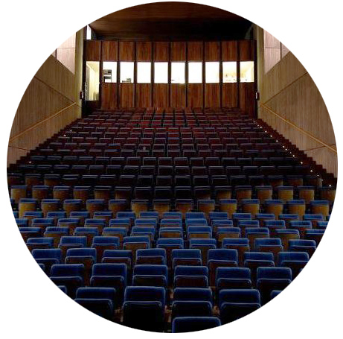
CULTURE

Slide 8
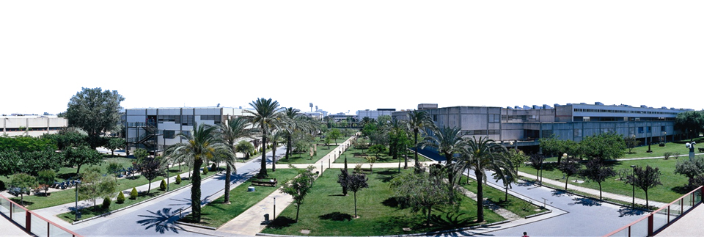
36.711 Students
2.640 Teaching and research staff
1.557 Administration and services staff
green areas:
106.000 m²

Slide 9
FACILITIES

Slide 10
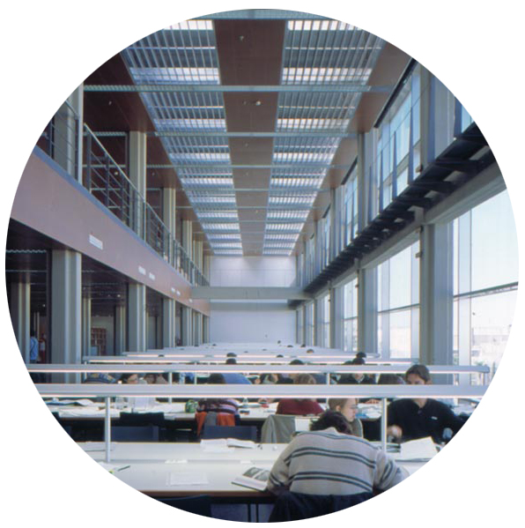
ADE-Topography library
Agrifood Engineering library
Building Engineering library
Design Engineering library
Civil Engineering library
Industrial Engineering library
Fine Arts Faculty library
Alcoy Campus library
Gandia – CRAI Campus library
1 central library
+10 specific libraries

Slide 11
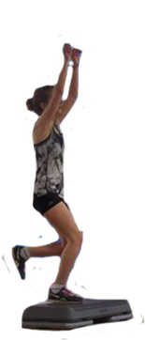
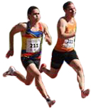
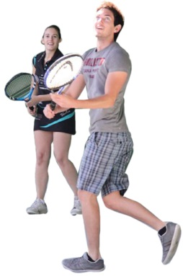
SPORT FACILITIES
Trinquet
Swimming
pool

Slide 12
OWN DIPLOMAS:
1.070 Students
SPECIFIC COURSES:
139 different diplomas
10.091 Students
1.444 Courses
CONGRESS:
3.672 Participants
40 Congresses
WORKING DAYS:
4.273 Students
177 short courses
CFP
TEACHING AND RESEARCH STAFF
686 from UPV
1.129 outside
171 ADMINISTRATION AND
SERVICES STAFF

Slide 13
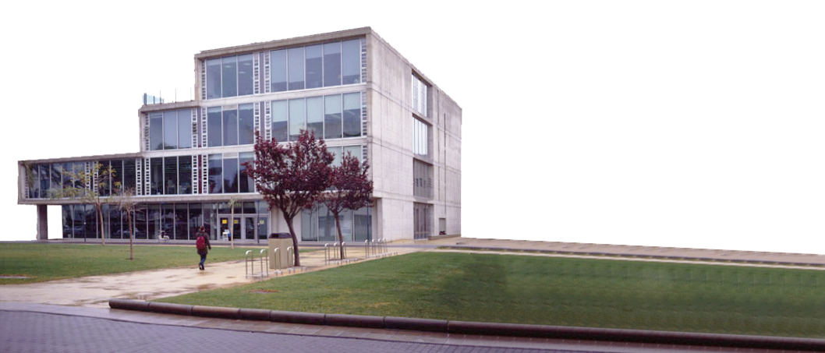
conferences
bicycle rental service
leisure
lounge
Tv
Vending machines
Board games
Billiard tables
Football table
Computers
Photocopier
printer
studio room
STUDENT’S CLUB

Slide 14
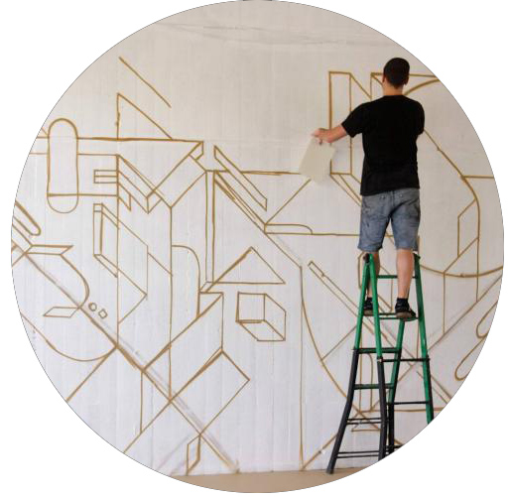
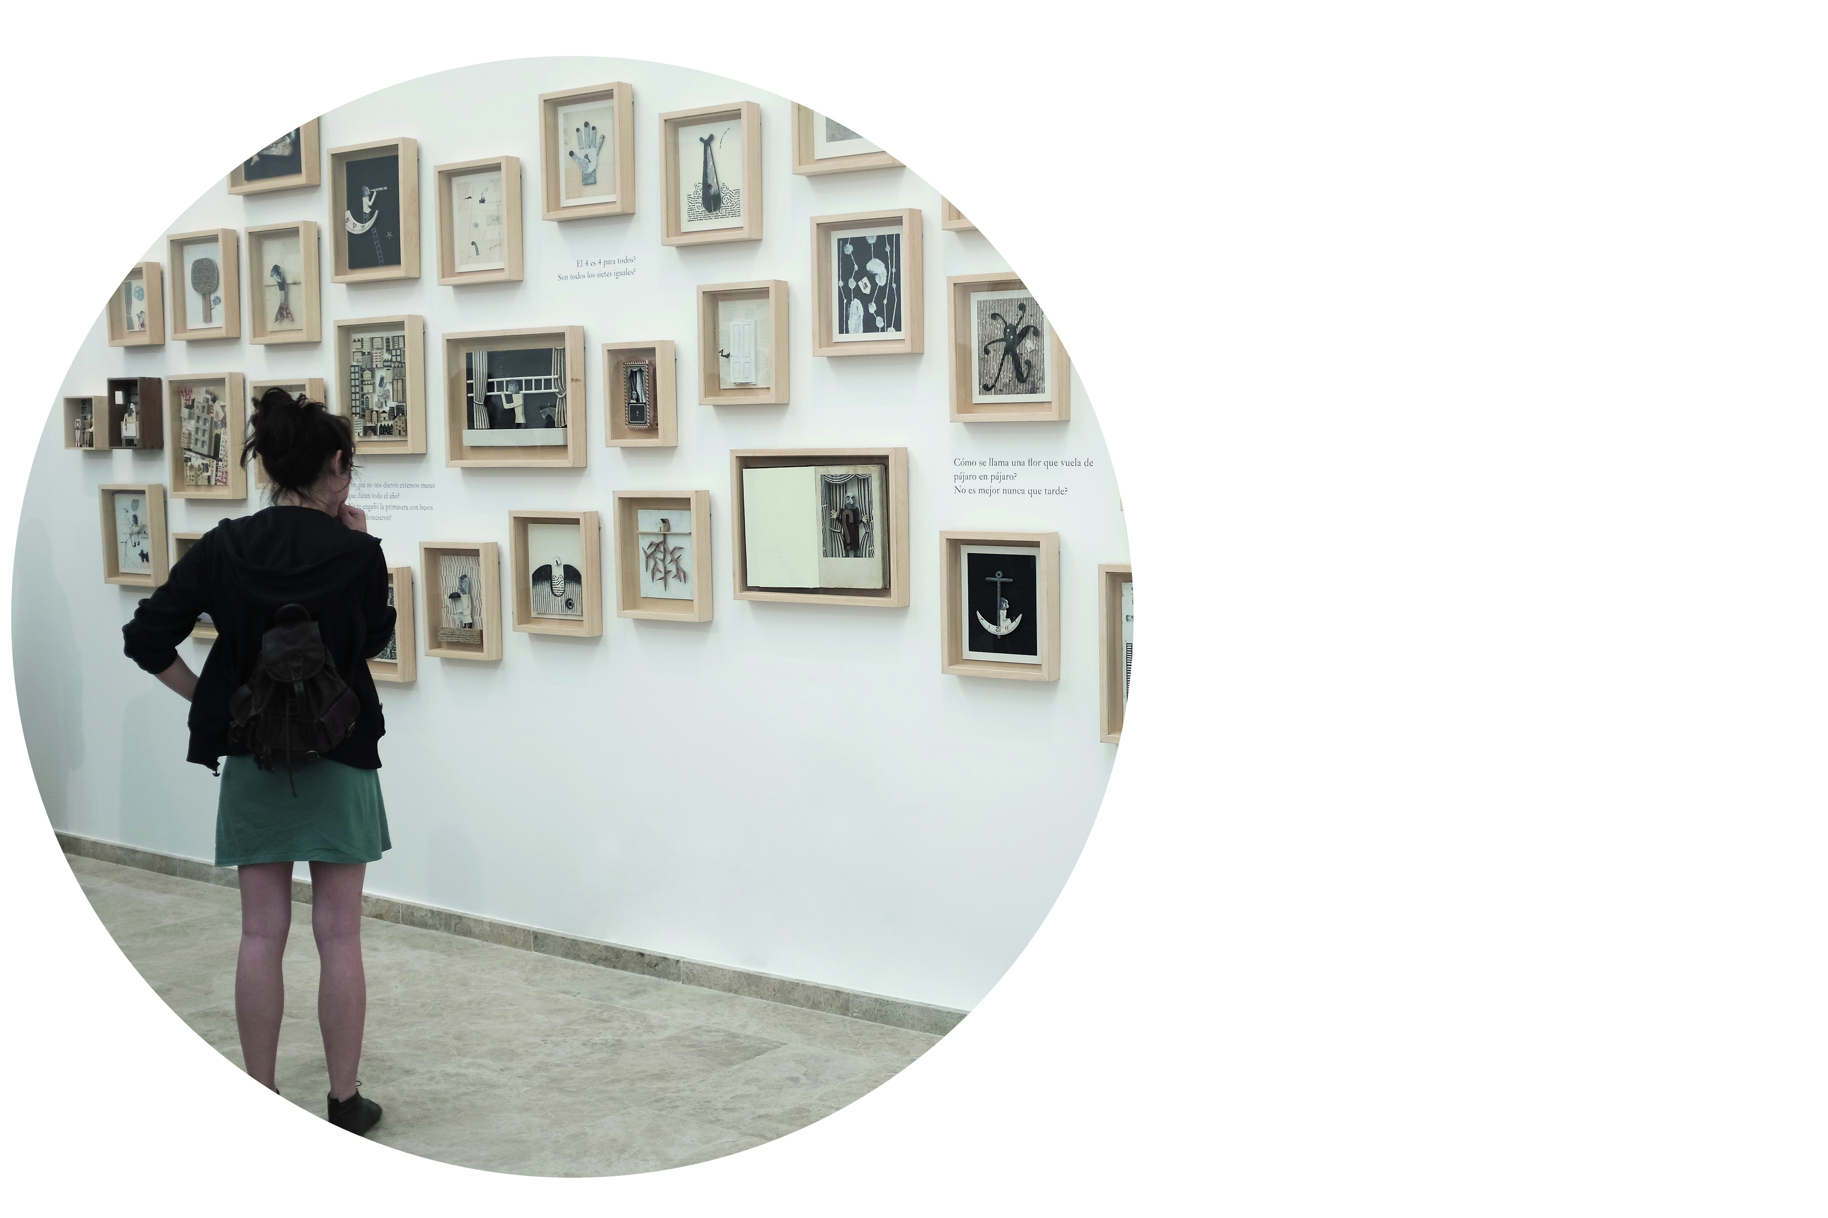
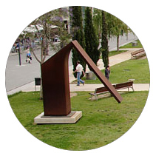
Sculptures
CULTURE
Culture events
Exhibitions

Slide 15
ACCOMMODATION
CAFÉ
RESTAURANT
HEALTH CENTER
HAIRDRESSER
BANK OFFICE AND ATMS
SHOPS
OTHER FACILITIES

Slide 16
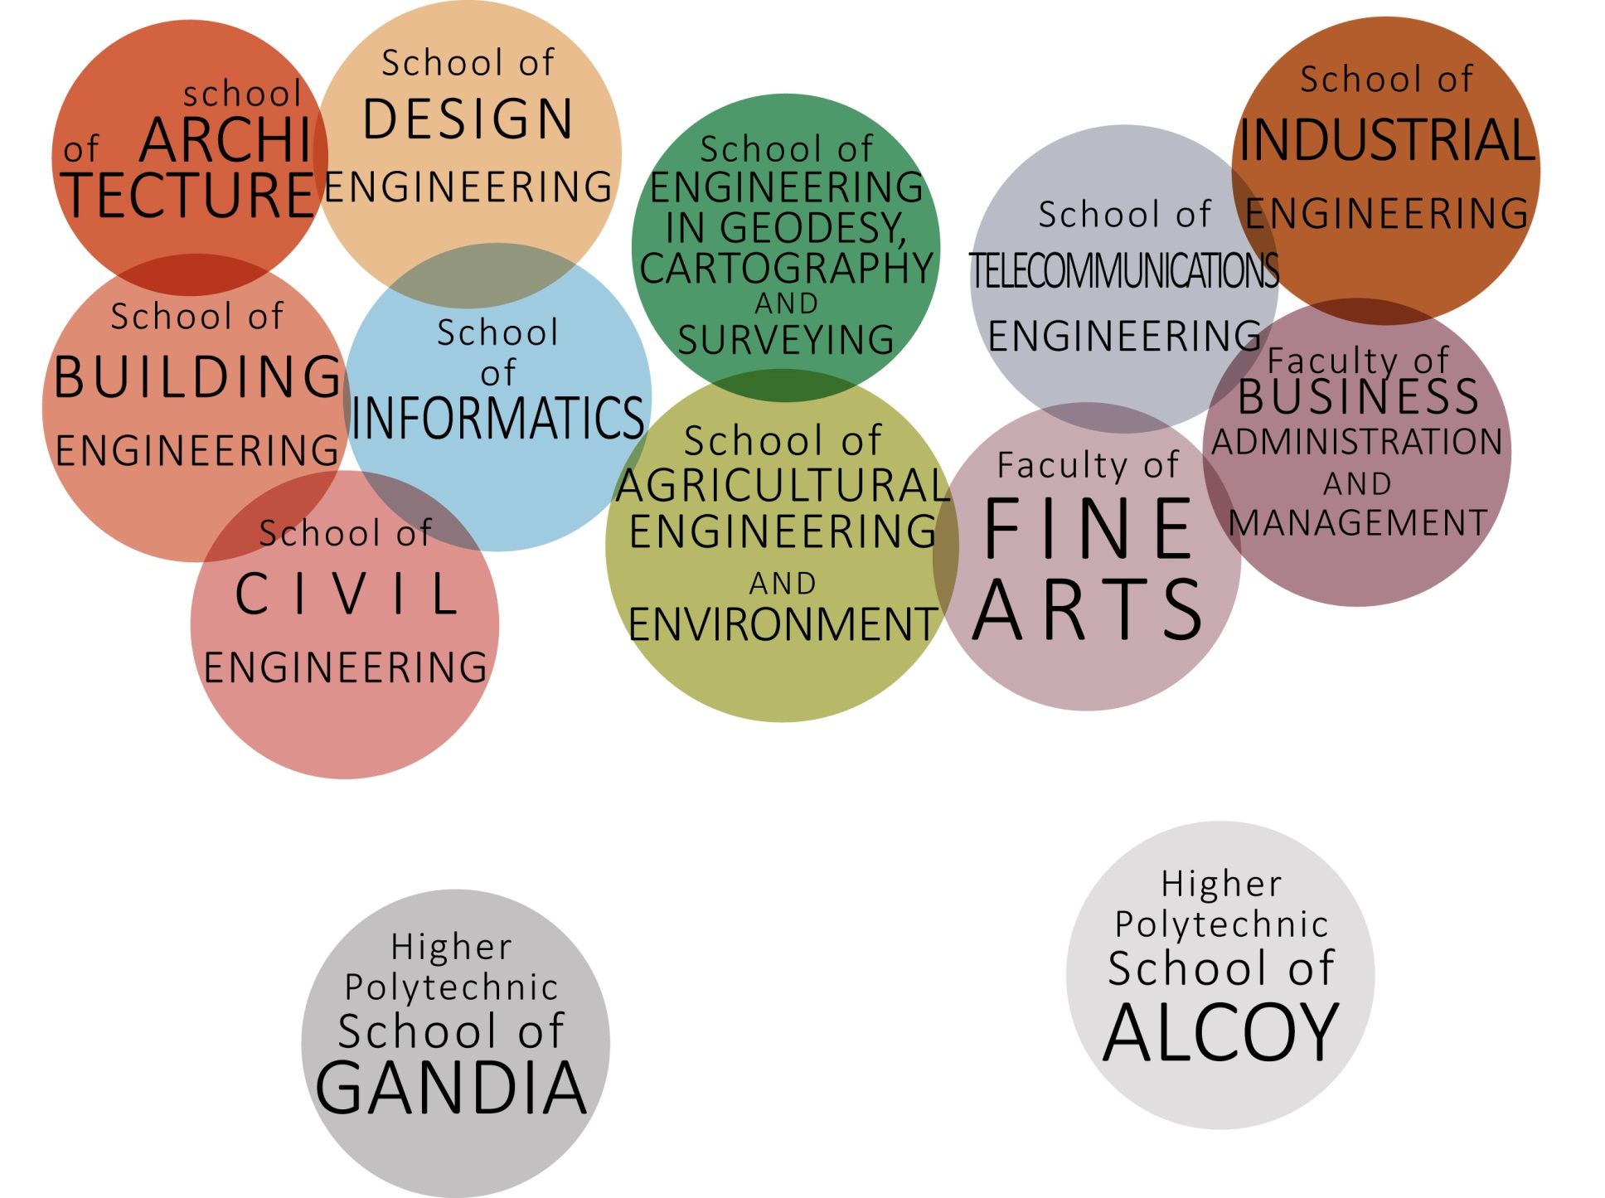
13 SCHOOLS AND FACULTIES

Slide 17
CAMPUS VERA
CAMPUS ALCOY
CAMPUS GANDIA

Slide 18
ETSIAMN
Bachelor's Degree in Biotechnology
Bachelor's Degree in Food Science and Technology
Bachelor's Degree in Forest and Environmental Engineering
Bachelor's Degree in Rural and Agrifood Engineering

Slide 19
Master’s Degree in Agricultural Engineering (AE)
Master’s Degree in Forestry Engineering
Master’s Degree in Enology
ETSIAMN

Slide 20
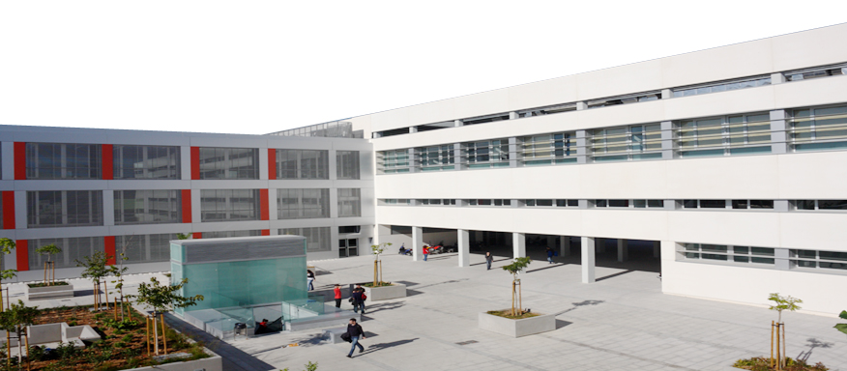
2711 Students
337 Teaching and research staff
85% with a PhD
ETSIAMN

Slide 21
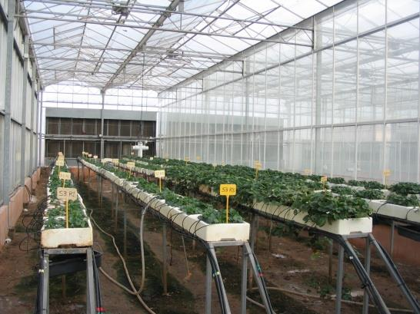
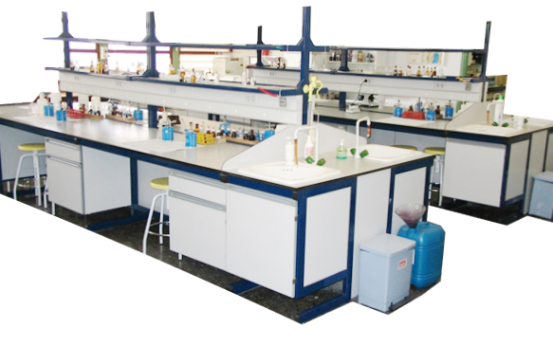
ETSIAMN FACILITIES

Slide 22
They are Series of guest lectures in Life Sciences
Regular elective course, 6 ects
Language of instruction English
Open to own and exchange students
Introduction to current research developments in Life Sciences
Problem solving
Teamwork
Debate
language skills
Evaluation through individual reports

Slide 23
SRING SEMESTER
AUTUMN SEMESTER

Slide 24
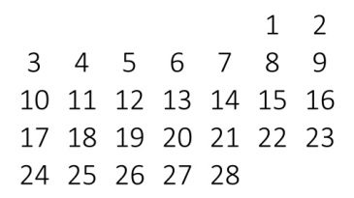
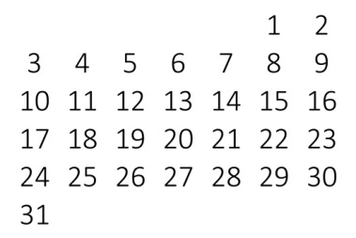
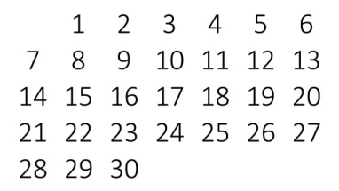
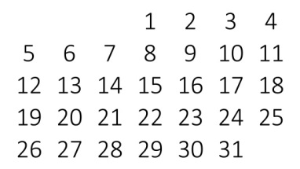
Van Damme, Patrick INTRODUCTION TO ETHNOBOTANY Ghent University (B)
FEBRUARY
Grishenkov, Dmitry EARLY DIAGNOSTICS AND MONITORING
OF PROGRESSION OF LIVER CANCER
KTH Royal
Institute of
Technology (S)
Strużyński, Andrzej HYDRODYNAMICS OF MOUNTAIN RIVERS
AND STREAMS. FLOOD RISK MANAGEMENT
Univ. of Agric. in Krakow (PL)
Van Erp, Lenny NATURAL BEHAVIOUR, ANIMAL REWARD
SYSTEMS AND BRAIN ENRICHMENT
Univ. of Applied Sci. in Den Bosch (NL)
MARCH
Mohareb, Fady APPLIED BIOINFORMATICS
Cranfield University (UK)
Moscatelli,Mª Cristina INDICATORS OF SOIL HEALTH IN
PRESENCE OF METALS
Università degli Studi
della Tuscia (I)
Hamid, Hamed AUTOMATED CLASSIFICATION OF ARTERY
PHYSIOLOGICAL CONDITION
KTH Royal Institute of Technology (S)
APRIL
Farkas, Tibor POPULATION DYNAMICS IN EUROPE
Szent Istvan Univ. in Gödöllö (HU)
Piecuch, Jakub EVOLUTION AND ACTUAL SITUATION OF
POLISH AGRICULTURE IN EUROPEAN CONTEST
Univ. of Agric. in
Krakow (PL)
MAY
Pérez, Edgar FOOD NANOTECHNOLOGY
Univ. Politècnica de Valencia (E)
Pluhár, Zsuzsanna NEW TRENDS IN CULTIVATION AND
PROCESSING OF MEDICINAL AND AROMATIC PLANTS
Corvinus University
in Budapest (HU)

Slide 25
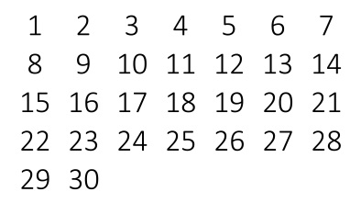
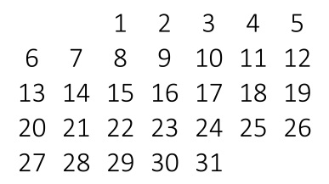
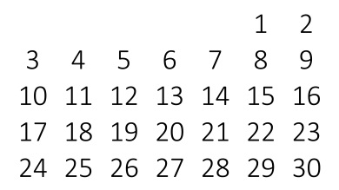
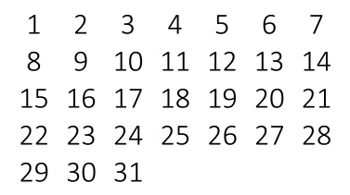
Univ. Life Sciences Lublin (PL)
Andrzej Salata PHARMACEUTICAL VALUE OF ARTICHOKE
SEPTEMBER
Delia Ojinnaka FOOD SECURITY/FOOD SUSTAINABILITY
London South Bank Univ. (UK)
Patrick van Damme INTRODUCTION TO ETHNOBOTANY
Ghent Univ. (B)
Winfried E.H. Blum SOILS AND FOOD SECURITY UNDER
GLOBAL CHANGE
BOKU Wien (A)
OCTOBER
Holger Kirchmann AMBITIONS AND LIMITATIONS OF
ORGANIC CROP PRODUCTION
University of Uppsala (S)
Joost Dessein ON THE GMO-REGIME IN EUROPE: HOW
CAN SCIENCE, POLITICS AND THE
PUBLIC DEAL WITH THIS WICKED PROBLEM
Ghent Univ. (B)
Bruno De Meulanaer FOOD ALLERGENS
Ghent Univ. (B)
NOVEMBER
Heide Hoffmann GREEN IN THE CITY –OPPORTUNITIES AND
LIMITS OF URBAN FARMING/GARDENING
IN ECOSYSTEM CITY___
Humboldt University (D)
Philipp Wiedemann BIOPHARMACEUTICALS: PRODUCTION AND
PROCESS MONITORING
HS Mannheim (D)
Agostina Chiavola OPTIMAL MANAGEMENT AND TREATMENT
OF OLIVE MILL WASTEWATER
AND RESIDUES________
University of Rome
(IT)
DECEMBER
Helmut Laberenz CULTURE INFLUENCING CONSUMER BEHAVIOUR
HS Hamburg ( D)

Slide 26
AVERAGE WORK PROGRAMME FOR VISITING LECTURERS
Visit on the UPV Campus:
main buildings and facilities
Welcome meeting.
Paperwork
Logistics
Programme Overview
Interviews with faculty, researchers and technicians
Internet time / leisure time getting ready for your lecture
THURSDAY
Seminar

Slide 27
AVERAGE WORK PROGRAMME FOR VISITING LECTURERS
Visits in labs,
research facilities,
joint lectures,
PhD seminars,
MSc Thesis
Programme to be agreed
FRIDAY

Slide 28
ETSIAMN
2005-2006
ETSIAMN
2013-2014
UPV SCHOOL AVERAGE
2013-2014
TS
Incoming
Outgoing
31
11
6
6
15
8
193
103
89
49
63
61
43
14
18
5
22
12
Non-TS
Incoming
Outgoing
Students for
PLACEMENTS
Incoming
Outgoing
ISLS in numbers
16 semesters
1572 students
184 speakers
99 Institutions
42 countries

Slide 29
Some qualitative outcomes
Organized, regular and fluent teaching staff mobility
Community, team of TS around your International Office
Internationalization at home
Improved institutional visibility
ISLS-like initiatives at Partner Institutions:
ENSAIA, KTU, UG, USAMV, ITESM, UNITUS,…

Slide 30
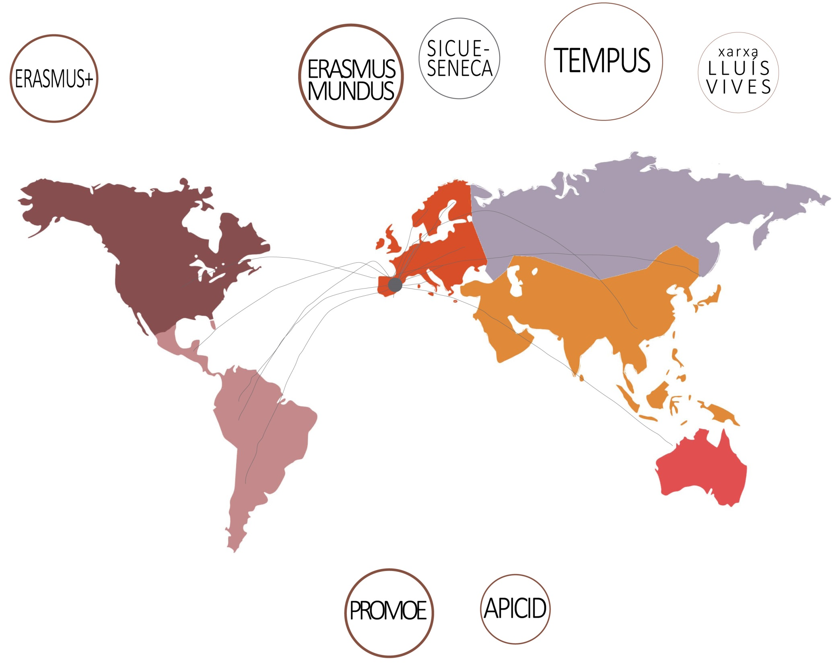
EXCHANGE PROGRAMMES

Slide 32
4.383 students got an internship through university programs
216 students went abroad
735 students got a job through SERVIPOLI
UPVSTUDENTS
INTERNSHIPS

Slide 33
COMPANIES
COLLABORATING
per year
INTERNSHIPS
per year
2011
2012
2013
618
572
576
588,67
260
247
255
254
average
ETSIAMNSTUDENTS
INTERNSHIPS

Slide 34
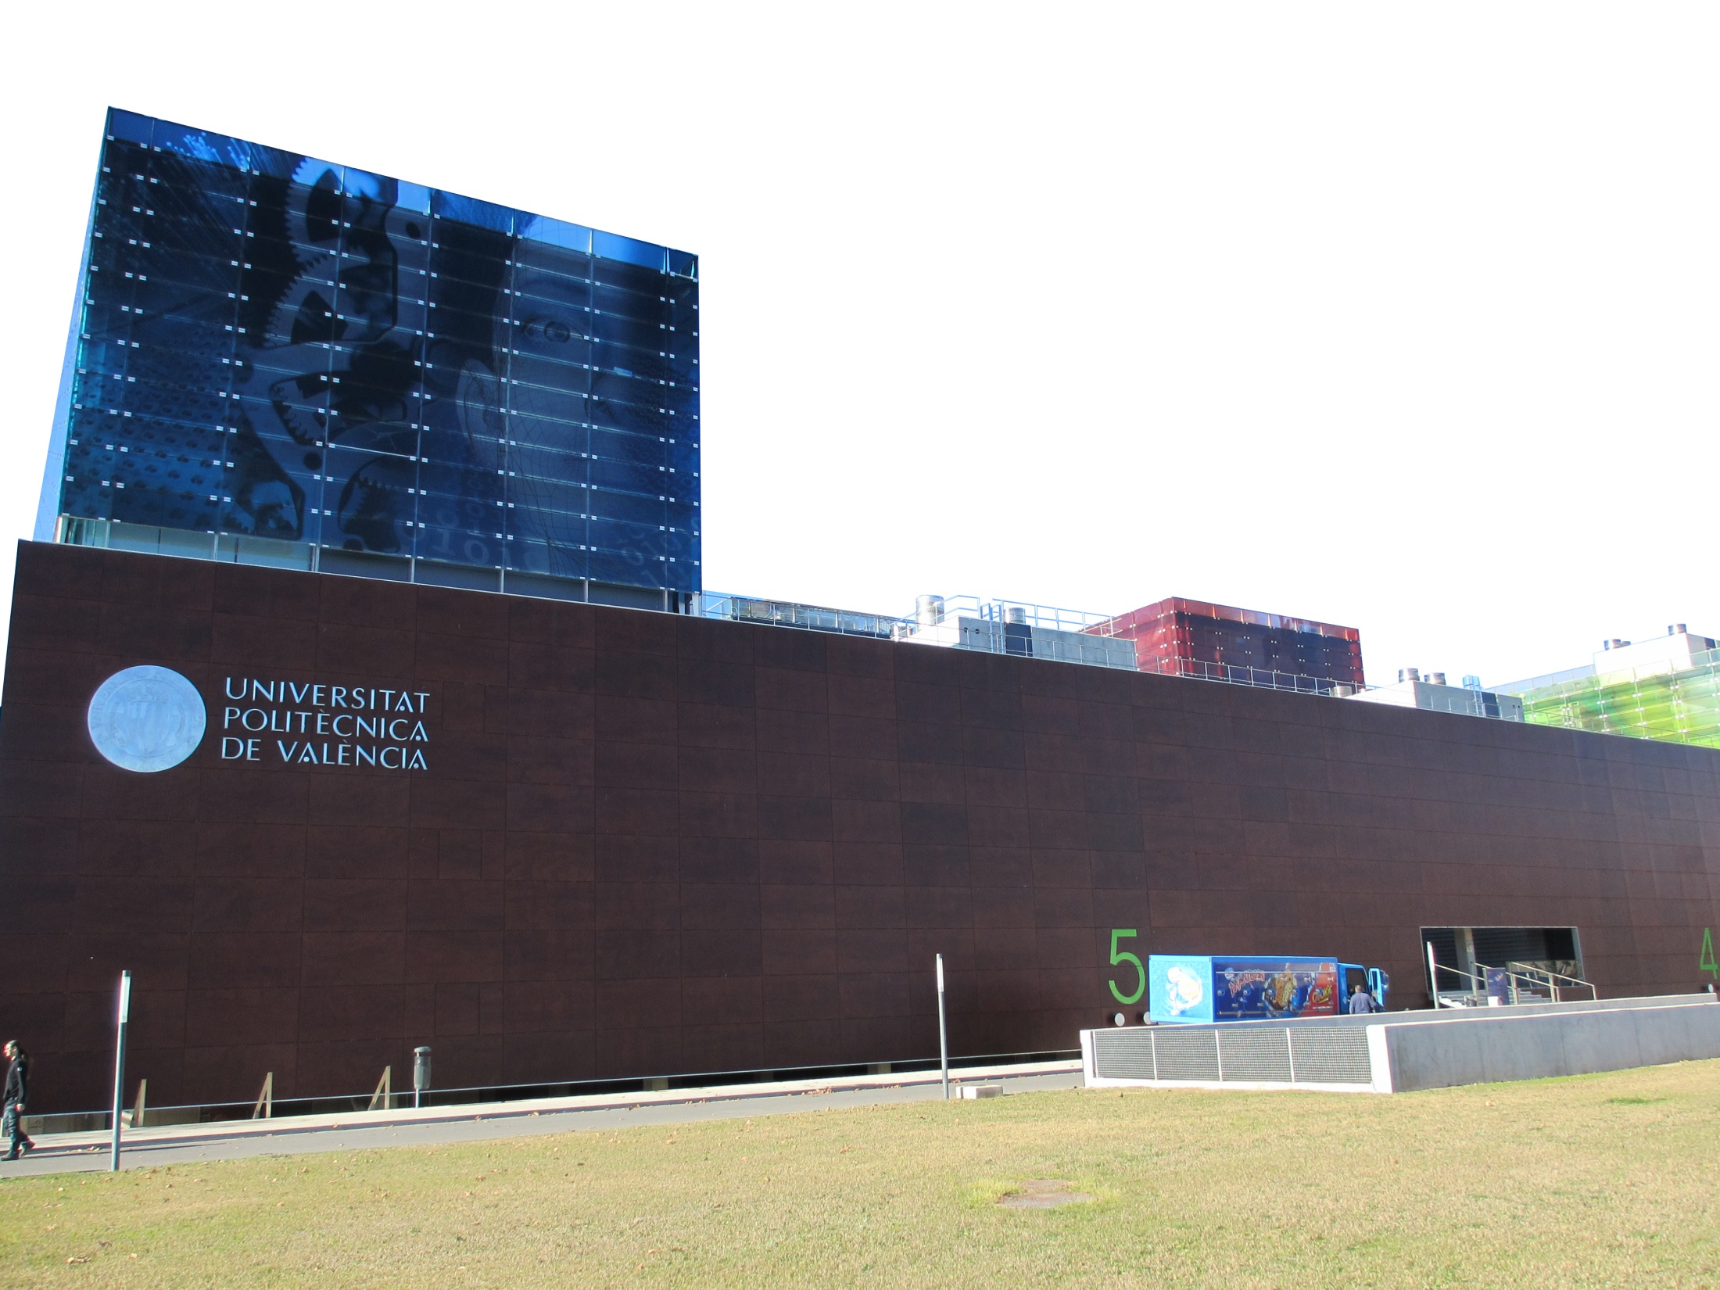
CÁTEDRA AINIA
CÁTEDRA BAYER-CROPSCIENCE
CÁTEDRA CONSUM
CÁTEDRA DIBAQ DE ACUICULTURA
CÁTEDRA FUNDACIÓN AGUA Y PROGRESO
CÁTEDRA FOMESA
CÁTEDRA INTERUNIVERSITARIA DE LA VIÑA Y EL VINO
CÁTEDRA SEIASA DE LA MESETA SUR DE LA UPV
CÁTEDRA TIERRA CIUDADANA
CÁTEDRA VICENTE SILVESTRE Y CONSUELO JULIÁN
INNOVA

Slide 35
MOBILITY
EDUCATION
EMPLOYMENT

Slide 36
ETSIAMN

