Slide 1
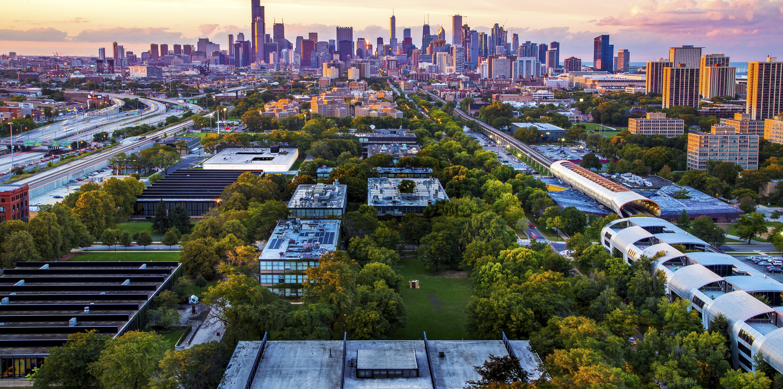
Presentation by
Dr. Vanita Misquita Ph.D.
October 3rd, 2023
6 – 7:00 p.m.

Slide 2
Presentation by
Dr. V. Misquita
Senior Director, International Partnerships
Office of International Affairs
Misquita@iit.edu

Slide 3
CONTENTS
About Illinois Tech – Illinois Tech alumni innovations/creations
Academic departments, Double Degree & Tech Pro Certificate programs
Transfer of credit
Cost & Partial merit scholarship
Research project – Projet/stage de fin d’études
Questions

Slide 4
STATS AT ILLINOIS TECH
Undergraduates: 2,879 students
Graduates: 3,700 students
Career Placement rate: 90.5%

Slide 5

Rankings & Recognition
#1 in Illinois, #32 in the nation for lifting students from families in the bottom 20% of income to the top 20% (Opportunity Insights)
#1 in Illinois, #23 in the nation (Wall street Journal College Pulse/Best Colleges 2024)
#2 in Illinois, #83 in the nation for 20-year net ROI after financial aid
(PayScale)
#98 Best National University and #29 Best Value School (U.S. News & World Report)
“National Universities” includes all institutions ranked by U.S. News & World Report that, in addition to bachelor’s and master’s degrees, offer a range of doctoral degrees and have a commitment to producing groundbreaking research.
Member of the AITU ( 23 members)

Slide 6
Notable Illinois Tech alumni

Slide 7
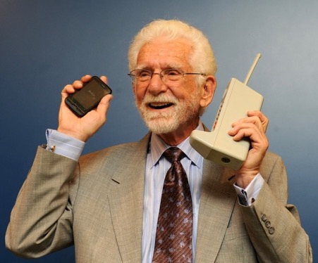
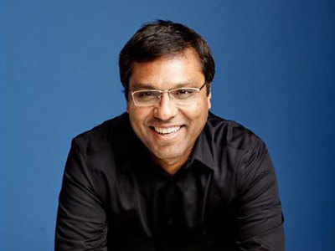
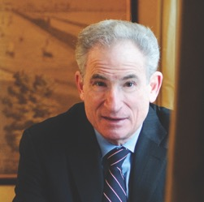
Illinois Tech’s innovations/discoveries/creations
Marty Cooper -Inventor of the cell phone 1972-73
Rohit Prasad – Head Scientist behind the creation of
Alexa
Ed Kaplan – Bar code printer technology pioneer -
“The fundamentals I learned at Illinois Tech have been my guiding light in everything I have done.”
– Martin Cooper
(B.S. EE 1950; M.S. EE 1957)
“The way I think about Alexa is the way AI is revolutionizing daily convenience.”
– Rohit Prasad
(M.S. EE 1999)

Slide 8
In the News
Jack Dongarra ( Illinois Tech alum – MS CS 1972) winner
of the ACM ( Association for Computing Machinery) Turing Award 2021
Jin-Ho Lee ( Illinois Tech alum- MS/Phd CS) new Chief
Technology Officer -2023 at Carrot General insurance –one of S.Korea’s
largest digital insurance companies
ONE OF THE NATION’S FIRST JOINT UNIVERSITY AND INDUSTRY ACADEMIES - Creation with company DMG MORI a national center for advanced manufacturing to train, develop and empower advanced manufacturing workforces of the future
DMG MORI is a worldwide leading manufacturer of high-precision machine tools and sustainable technologies that are at the center of global value chains.”https://en.dmgmori.com

Slide 9

ATHLETICS
Men’s
Baseball
Basketball
Cross Country
Lacrosse
Soccer
Swimming and Diving
Tennis
Track and Field
Volleyball
Women’s
Basketball
Cross Country
Lacrosse
Soccer
Swimming and Diving
Tennis
Track and Field
Volleyball

Slide 10
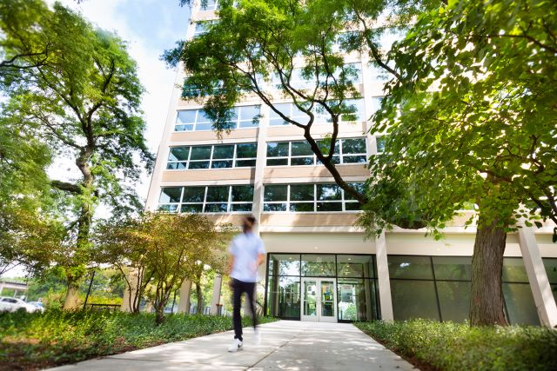
Campus Housing
Residence Halls
McCormick Student Village
Jeanne and John Rowe Village
Gunsaulus Hall
Carman Hall
George J. Kacek Hall

Slide 11

Single Room- Kacek Hall

Slide 12
Room and Meal rates on-campus housing
ROOM RATES ON CAMPUS: August 2023-May 2024
https://www.iit.edu/housing/housing-options/housing-rates
Cost range: $8,758-$15,442 for the academic year
BOARD/MEAL RATES ON CAMPUS:
https://www.iit.edu/housing/dining-and-meal-plan/options-and-rates
Cost range: $1,886 - $7,910 for the academic year
Graduate(Master and Doctoral level) students are NOT required to live in on-campus housing

Slide 13
Illinois Tech Partners in Spain
Universidad Politecnica de Madrid
(ETSIT, ETSIINF, ETSIAAB, ETSII, ETSICCP, ETSAM,
ETSIME, ETSIDI)
Universitat Politecnica de Valencia ( ETSII, ETSIT, ETSA,
ETSIAMN)
Universitat Politecnica de Catalunya ( ETSETB, ETSEIB,
FME, ETSAB, ETSECCPB, EEBE)
Universidad Del Pais Vasco ( EIB-School of Engineering)
Universidad de Seville ( School of Engineering, Faculty of Psychology)
IE School of Architecture and Design, Madrid
ICAI Comillas, Madrid

Slide 14
Departments at Illinois Tech
ARMOUR COLLEGE OF ENGINEERING
Department of Civil, Architectural & Environmental Engineering – www.iit.edu/caee
Department of Electrical & Computer Engineering - www.iit.edu/ece
Department of Biomedical Engineering - www.iit.edu/bme
Department of Industrial Technology & Management – www.iit.edu/intm
Department of Chemical and Biological Engineering – www.iit.edu/chbe
Department of Mechanical, Materials & Aerospace Engineering – www.iit.edu/mmae
COLLEGE OF COMPUTING
Department of Computer Science – www.iit.edu/computer-science
Department of Applied Mathematics – www.iit.Edu/applied-mathematics
Department of Information Technology & Management – www.iit.edu/itm
LEWIS COLLEGE OF SCIENCE & LETTERS
Department of Physics – www.iit.edu/physics
Department of Chemistry – www.iit.edu/chemistry
Department of Biology – www.iit.edu/biology
Department of Food Science & Nutrition – www.iit.edu/fdsn
STUART SCHOOL OF BUSINESS - www.stuart.iit.edu
COLLEGE OF ARCHITECTURE – www.arch.iit.edu

Slide 15
Why study at Illinois Tech?
Illinois Tech is the only tech focused university in Chicago
Chicago is the 3rd largest city in the U.S, opportunities for networking and jobs aplenty – home to more than 30 Fortune 500 companies
Argonne National Laboratory and Fermilab – world famous laboratories – are located within an hour of Illinois Tech
Possible to complete a Master’s degree in 1 year (12 months) at IIT in ANY FIELD WITH APPROVAL FROM HOME INSTITUTION
Tuition is the same for all students regardless of field of study Engineering/Tech/Sc/Business
No quotas at the Master’s degree level – Illinois Tech Partner Alliance scholarship – 9 credits for the 1 –year Master for Engineeering/Technology/Science/Business fields
F1 visa allows students to work for 1 year in the U.S. in their field of study or 3 years if the program has been designated as STEM

Slide 16
Master’s Degree Program
What are the types of Master’s degree program at IIT?
M.S. ( Master of Science): MAS ( Professional Master’s): M.Eng. ( Master of Engineering)
Are they all accepted in the work place? YES
How many credits are in different Master’s degree programs? 30 credits or 32 credits of 33 credits
What is the ECTS credit equivalency to the U.S. credit system? 2 ECTS = 1 US Credit
Which Master’s degree and program fields are applicable? All – as long as the home institution
approves of the Master’s degree and field chosen
What is the meaning of program fields? Examples – electrical engineering, or power engineering, or AI, or
Cybersecurity etc. Degree programs offered are per field of study
Can one take any course from any department in a Master’s degree program? No
All Master degree programs comprise core courses and a certain number of electives that a student must
complete related to his/her field of study. A couple of elective courses from another department is possible
with approval from the student’s academic adviser IIT

Slide 17
DOUBLE DEGREE PROGRAM

Slide 18
2nd/Year
1st/Year
1 yr Master
IIT Master’s degree with TFM
Master’s degree equivaelent
from home institution

Slide 19
INTERDISCIPLINARY PROGRAMS
Armour College of Engineering
M.Eng – Computational Engineering – Biomedicine Track ( BME dept.)
M.Eng – Computational Mechanics – (MMAE dept)
M.Eng – Computational Engineering – Optimization Machine Vision & Decision-Making track ( ECE dept)
M.Eng – Energy Systems, Energy Transmission & Markets track (ECE dept)
M.Eng – Engineering Management – Product Design & Development Track ( MMAE Dept)
M.Eng – Advanced Manufacturing – Additive& Digital Manufacturing Tracks ( MMAE dept)
M.Eng – Advanced Manufacturing – Automation & Control Systems track ( ECE dept)

Slide 20
Career Opportunities & a quick google search ( unscientific) of average annual salaries in the U.S. per job title
Computational Fluid Dynamics Analyst – 94K
Core Algorithm developer – 88K
Senior Machine Learning optimization engineer – 100K
Computer Vision Software developer – 83K
Energy Efficiency specialist – 66K
Transmission Engineer – 100K
Transmission and Distribution line engineer -97K
New Product Development Engineer – 100K
Product Engineering designer – 95K
Advanced Manufacturer Engineer – 81K
Image Processing Engineer – 100K
Automation Control Systems Engineer – 85K
Senior Automation controls Engineer – 99K
Systems Energy Engineer – 100K
Senior Energy Engineer – 93K …………;;

Slide 21
A few examples of Master degree program at IIT
M.Eng – Construction Engineering & Management
M.Eng – Energy Systems, Energy Conservation & Buildings Track
M.Eng – Power Engineering
M.Eng- Advanced Manufacturing, Automation & Control Systems Track
M.Eng – Artificial Intelligence for Computer Vision & Control
M.Eng – Computer Engineering in IoT
MAS – Industrial Technology & Management
M.A.S. – Artificial Intelligence
M.A. S - Cybersecurity
M.S. Financial Economics
M.S. Computer Science
M.S. Electrical Engineering
M.S. Computer Engineering
M.Eng Civil Engineering or Architectural Engineering or Environmental Engineering
M.S. Technological Entrepreneurship ….
And a lot more…….

Slide 22
STUART SCHOOL OF BUSINESS PROGRAMS
S.T.E.M. Designated programs
M.S. Finance
M.S. Financial Economics
M.S. Management Science and Analytics
M.S. Marketing Analytics
M.S. Technological Entrepreneurship
M.S. Project Management
M.S. Sustainability Analytics and Management
Eligible for 3-course transfer credit for SSB programs
Eligible for a 9-credit hour scholarship for SSB ( only one scholarship will apply) *
*If choosing one of the SSB programs will be eligible for 9 ch scholarship. Only eligible for ONE scholarship.

Slide 23
Double Degree Master’s program
Preselection by the partner school ( only preselected students may apply)
Official proof of English language proficiency:
TOEFL ibt ( not home edition) 80 overall and 20 in all bands
Or
IELTS ( not home edition) 6.5 overall and 6.0 in all bands
GRE general waived for Spring 2024 and Fall 2024
Final decision made by Illinois Tech

Slide 24

Academic Calendar
SPRING 2024 SEMESTER
Begins January 8, 2024
FALL 2024 SEMESTER
Begins August 19, 2024

Slide 25
Application deadlines
SPRING SEMESTER FALL SEMESTER
Application: October 15 Application: April 15
Financial Support: May 31 Financial Support: November 1
Intent to Enroll: July 1 Intent to Enroll: December 1
Deposit: Waived @Graduate level Depoist: Waived @ Graduate level

Slide 26
Research project/ Trabajo fin de Master
Number of credits assigned by the IIT department by substituting one or a maximum of 2 elective courses (3 credits or up to 6 credits maximum depending on course elective substitution and program)
Course number – xxx597 ( if a letter grade is required) or xxx 594 (if only Pass/Fail)
Credits MUST BE spread out over the year including the summer if necessary
Number of hours required by the home institution has NO RELATION to the credit hours IIT awards
Work expectations and outcomes for the project
Project may be presented in front of a committee if required by the home institution
A research paper/Guidelines per the home institution may be required
Evaluation form may be required by the home institution

Slide 27
TRANSFER OF CREDIT
What is transfer of credit or credit transfer?
Course successfully completed ( 6.5 out of 10 ) at the Master’s level at the home institution that may be
compatible in number of hours and content. Only such courses may be submitted for transfer credit
evaluation. 1 U.S. Credit = 2 ECTS
Is it a guarantee that the courses for submitted for transfer of credit will be approved?
NO – courses are evaluated on a case-by-case basis and may or may not be approved.
How many courses can be submitted for transfer of credit?
Up to 6 U.S. credits ( about 2 courses @ 3 U.S. credits each) or, if pursuing a Master’s degree offered by
the Stuart School of Business – up to 9 U.S. credits ( about 3 courses @ 3 U.S.credits each)
What if one or all of the courses submitted for transfer credit are not approved?
The student will have to take them at IIT and pay for those courses, and this could delay
graduating in 12 months. The scholarship will NOT apply
What if the 6 credits or 9 credits are approved for transfer credit?
The student will not need to retake those courses as part of their degree program. This will reduce the
credit load ( if a Master’s program of 30 credits) to 24 credits ( 30 – 6)

Slide 28
PREREQUISITES
For any Master degree applicant, the Computer Science department requires proof of successful completion ( 6.5 out of 10) of the following pre-requisites:
CS 201 – Accelerated Introduction to Computer Science (4 US Credits): CS 401 – Introduction to Advanced Studies 1 ( 3 US Credits) and CS 402 – Introduction to Advanced Studies II ( 3 US credits) and CS 430 ( Introduction to Algorithms)
For the MSCS, MCS and Master of AI programs: Successful completion ( 6.5 out of 10) of CS 450 (Operating systems) is highly recommended. Additionally successful completion of CS 330 Discrete Structures: CS 331 – Data Structures & Algorithms: CS 350 – Computer Org. & Assembly Lang Programming: CS 351 – Systems Programming and Calculus and knowledge of a high-level programming course such as C or Java may be substituted for C++ http://bulletin.iit.edu/undergraduate/courses/cs/
https://science.iit.edu/computer-science/programs/graduate/graduate-program-resources/prerequisite-undergraduate-coursework
During the application process, the courses passed and corresponding to CS 201, 401 and 402 may be indicated separately and
uploaded with the transcript
For any Master degree applicant to the DEPARTMENT OF ELECTRICAL & COMPUTER ENGINEERING proof of
successful completion of the following courses are required: Probability & Statistics – Math 474 ( 3 US credits) and Signals
and Systems – ECE 308 ( 3 US credits)
http://bulletin.iit.edu/undergraduate/courses/ece/
http://bulletin.iit.edu/undergraduate/colleges/computing/applied-mathematics/#coursestext

Slide 29
EXAMPLES OF FIELDS OF STUDY AND CAREER PATHS
M.S. Autonomous Systems & Robotics – Career Path – Control systems engineer, Autonomous systems engineer, robotics engineer, interface developer, navigation & guidance systems engineer -
Median Salary – Robotics Engineer – 105K – skills required – Python, CS, Robotics, Communications, Automation
M.Eng Manufacturing Engineering – Career Path –Mechatronics Engineer
Median Salary – 105K – skills required –Troubleshooting, Problem solving – SolidWorks ( CAD), Mechanical engineering, Mechatronics, Communications
M.Eng Materials Science Engineering – Career Path – Materials Scientists
Median Salary – 99K – skills required –Communications, Chemical engineering, Materials Science, Research, chemistry
M.Eng Mechanical & Aerospace Engineering – Career Path – Aerospace Engineer
Median Salary -118K – skills required – mechanical engineering, management, aerospace Engineering, communications, systems
M.Eng AI, Computer Vision & control – Career Path – AI engineer, Computer vision Engineer, Computer Information Systems engineer
Median Salary – 153K – skills required –operations, planning, leadership, communications, management
M.A.S. Cybersecurity Engineering – Career Path –Data Warehousing Specialist –
Median Salary – 120K – skills required –Communications, management, leadership, Data Management, Operations….
LEARN MORE……

Slide 30
August 2023-May 2024 cost - GRADUATE
Graduate level ( Master’s): Cost per credit hour = $1,712
Master’s degree programs:30 credits ( $51,360): 32 credits ( $54,784) :
33 credits ( $56,496)
Is the cost the same for all Master’s degree programs? YES
Is the cost the same for domestic & international students? YES
Does IIT offer a partial merit scholarship? Yes – 9 credits ( $15,408) for
Engineering/Tech and Stuart School of Business programs
Will the approval of transfer of credit reduce my cost? Yes – Less 6 credits or for
the Stuart School of Business 9 credits
What will the total tuition cost be if one qualifies for admission and if approved for
the transfer of credit? Example: 32 credit Master’s – 9 credits ( scholarship) – 6
credits ( transfer of credit if approved) = 17 credits to pay for x $1712 = $29,104

Slide 31
Mandatory & Other fees
( August 2023-May 2024)
Student Service Fee $1,500
Health Insurance $2,286
Student Activity Fee $250
U-Pass fee ( optional) $310
New Student Fee $300
Graduation Fee $200
Total: $4,846
N.B.: Cost may change for the academic year August 2024-May 2025. Updates will be available by March 2024 on
https://www.iit.edu/student-accounting/tuition-and-fees/future-tuition-and-fees/mies-campus-graduate

Slide 32
August 2023-May 2024 cost - GRADUATE
Cost per Credit Hour: $1,712 ( August 2023-May 2024) ONLY APPLIES to Europe partner school students pursuing 1-year Master level programs in Engineering/Technology/Science
Example if admitted to Illinois Tech:
32-credit hour Master $54,784
a)IIT Partner Alliance scholarship 9 credits = - $15,408
(if an applicant qualifies for admission to IIT)
b) Eligibility for a 2-course (6 c.h.) transfer credit = - $10,272
(if approved for Engineering/Technology)
Tuition total applying a) & b) = $29,104
N.B. - Cost may increase for August 2024-May 2025. Check the web link below for the new cost in Feb/March 2024.

Slide 33
August 2023-May 2024 cost - GRADUATE
Cost per Credit Hour: $1,712 ( August 2023-May 2024) ONLY APPLIES to Europe partner school students pursuing 1-year Master level programs in Business
Example if admitted to Illinois Tech:
33-credit hour Master $56,496
a)IIT Partner Alliance scholarship 9 credits = - $15,408
(if an applicant qualifies for admission to IIT)
b) Eligibility for a 3-course (9 c.h.) transfer credit = - $15,408
(if approved for Engineering/Technology)
Tuition total applying a) & b) = $25,680
N.B. - Cost may increase for August 2024-May 2025. Check the web link below for the new cost in Feb/March 2024.

Slide 34
Is the Double degree program at Illinois Tech worth it?
- 2 degrees – in one year
- Wide variety of Master degree programs
- No quotas
- Work possibilities globally: in the U.S. – up to 3 years of work, if program is S.T.E.M. under the F1 student visa
- Experience in two different cultures, languages learning/pedagogical approaches
- Average annual salaries in the U.S. for Master degrees in Engineering/Technology/Business fields are high
- Good ROI (Return on Investment)

Slide 35
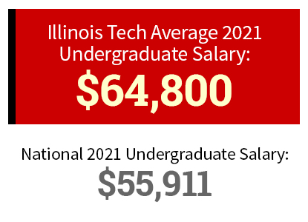
About Illinois Tech
COMPARISON: Starting Salary Undergraduate ( Bachelor’s level)
Advanced Degree (Master’s) Starting Salaries
The salary information listed below is based on student-reported starting salaries and data from Optional Practical Training (OPT) – mean:
$76,844 Yearly Median: $70,661 Yearly

Slide 36
Advantages/Benefits
Master’s d’IIT : $29,000
Annual salary in the U.S. upon graduation = $65,000 ( on average) (+20% )
New car = $29,000
Value when it leaves the showroom = -20%

Slide 37
TESTIMONIES
Why did you choose the DD program with IIT?
Le Double Diplôme a été pour moi un jalon essentiel pour la concretization de mon projet professionnel que je poursuis actuellement par un Doctorat au Laboratoire SMS-ID à l’INSA L.
What were some advantages?
a) De travailler an collaboration avec des professeurs exceptionnels
b) D’acquérir les bases méthodioligiques et les standards de conduite des projets de recherche
c) D’acquiérir des connaissances pointues dans les domaines de la conception et du calcul des structures, en validant avec succes les course approfondis suivants: Seismic Design, Advanced Structural Analysis
d) J’ai eu également l’opportunité d’assister à des conferences et à des séminaires scientifiques de renoms dans le domaine des structures tels que le 14th Annual Bridge Symposium organisé par “The American Structural Engineering Association
CHAIMAA JAAFARI MS-CAEE IIT 2017

Slide 38
TESTIMONIES
Best features “IIT’s location in Chicago..
Great studying environment..proximity to offices of the biggest corporations in the U.S. opens access to face-to-face networking opportunities”
Was the experience worth it?
“..for students studying in France, it allows them to broaden their knowledge by getting familiar with American codes and design methods – one of the most used design & constructions standards in the world”
Financially – affordable and possible with IIT ‘s scholarship & other scholarships from the regional council in France
“It was a great experience because I was able to interact with people with different backgrounds and get education from highly competent and experienced professors”
M. Hamza SEKKAK
(MS CAE IIT 2017 – INSA Lyon)

Slide 39
TECHPRO CERTIFICATE
ONLINE PROGRAM

Slide 40
Tech Pro Certificate program
Level – Master’s
Delivery: Online – synchronous and/or asynchronous
Number of credits: 9 or 12 credits ( 3 or 4 courses)
Duration of completion: One semester or over two
semesters
Outcomes: Upskilling and/or Pathway to a Master’s degree
program at IIT
Application deadlines: January 3- Spring: August 15
–Fall: May 15 - Summer
Webpage:
https://www.iit.edu/admissions-aid/graduate-admission/tech-pro-certificates

Slide 41
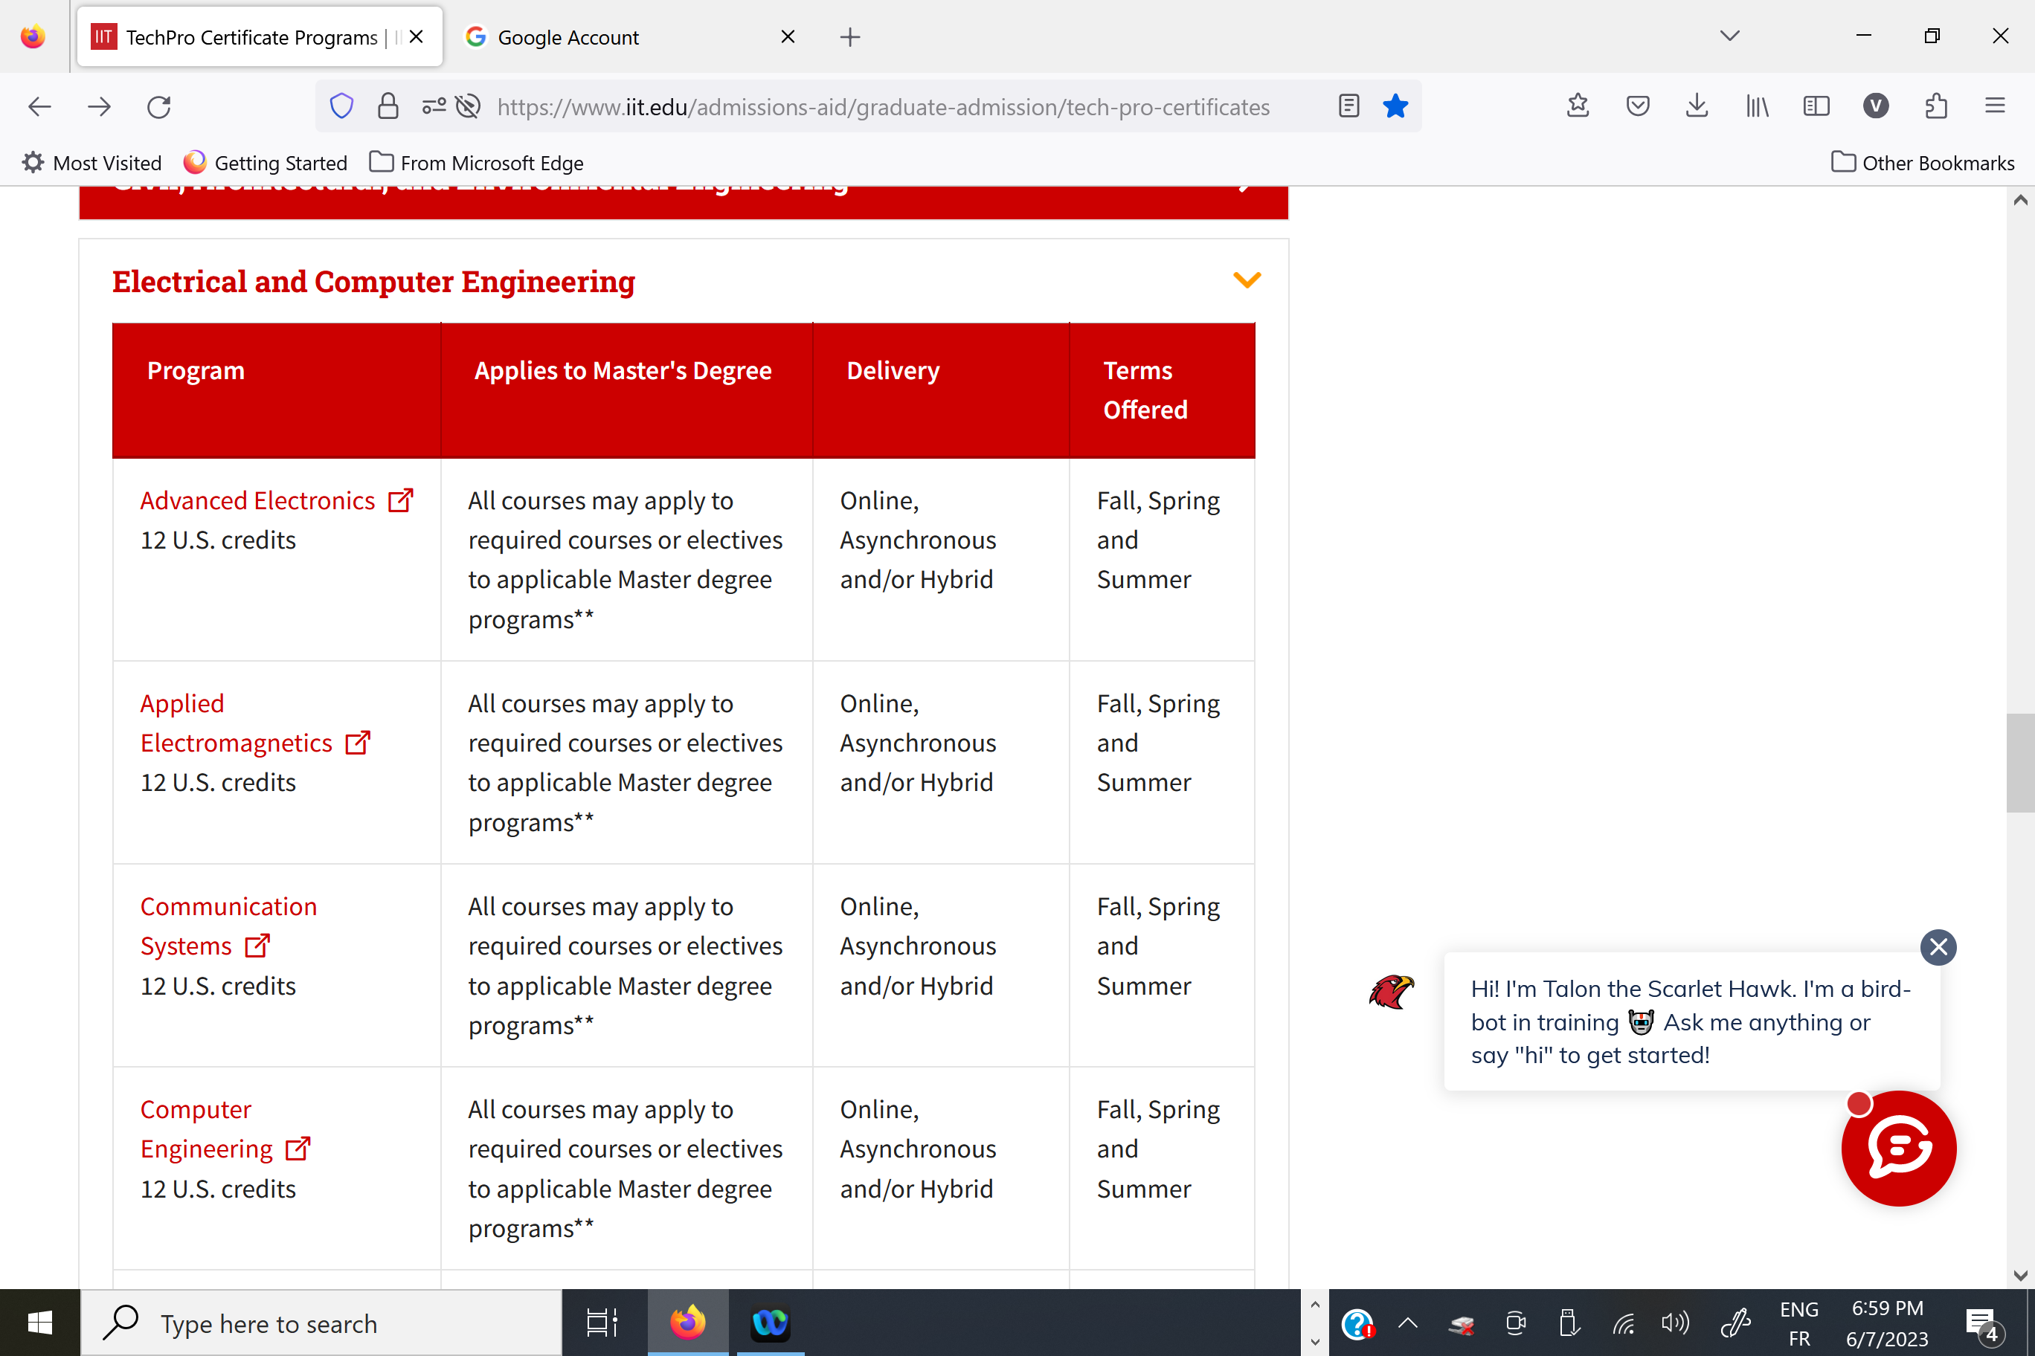
Tech Pro Certificate program examples

Slide 42
Tech Pro Certificate program
Cost of the Certificate program (August 2023-May 2024) @$1712 per credit hour
Actual cost 50% scholarship
9 credits $15,408 $7,704
12 credits $20,544 $10,272
13 credits $22,256 $11,128
N.B.:
For partner school pre-selected student(s), a 50% scholarship will be offered per course ( i.e. 3ch course = $5,136 @ 50% = $2,568), if the student chooses to take one or two courses in the certificate program that may apply to the Master’s program at Illinois Tech should the student wish to pursue the DD program at Illinois Tech later
Or
b) 50% scholarship offered for the entire certificate program for pre-selected student(s)
N.B.: The New cost for August 2024-May 2025 will be posted in Feb/March 2024 on the Student accounting link below:
https:/:web.iit.edu/student-accounting/tuition-fees/future-tuition/main-campus-graduate

Slide 43
Student research projects
Elevate competitions: https://elevate.iit.edu/experiences/category/competitions-outside-courses/
IIT alumna – Andy de Fonseca – https://www.google.com/search?client=firefox-b-d&q=Youtube+Illinois+tech+rocket+launch#fpstate=ive&vld=cid:79466b8d,vid:PsRIMbpvLwU,st:0
Illinois Tech Rocketry ( ITR) - https://www.iitrocketry.com/

Slide 44
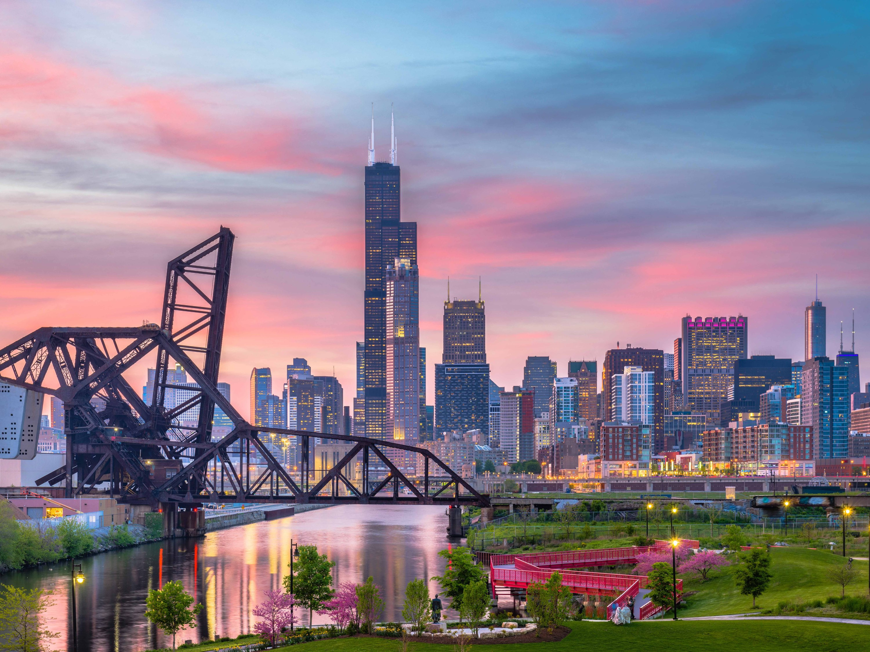
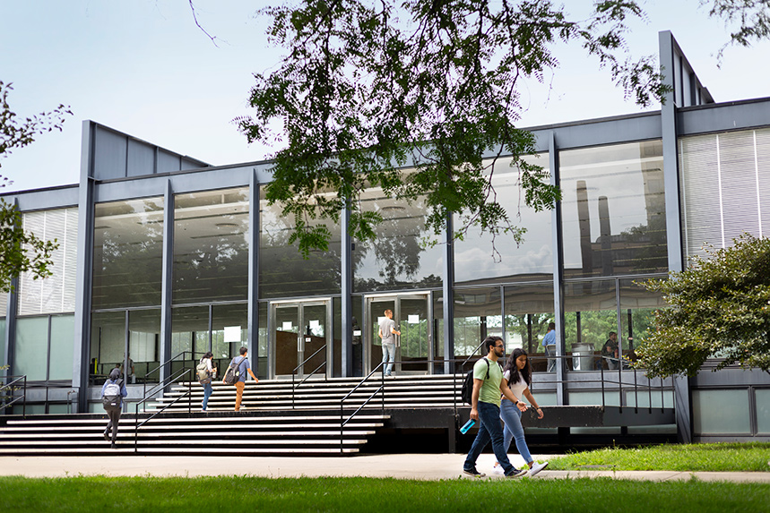
Are you ready to start the journey of a lifetime in Chicago at Illinois Tech?

Slide 45
Questions??

